Slide 1
Congenital adrenal hyperplasia
Dr. Elio Quesada Gonzalez
Consultant Pediatrician

Slide 2
Overview
Types of CAH
Clinical manifestations
Diagnosis
management
references

Slide 3
Congenital adrenal hyperplasia is a group of inherited genetic disorders that affect the adrenal glands ,a pair of walnut sized organs above your kidneys.
It is associated with an inability or reduced ability to produce cortisol, aldosterone or an overproduction of adrenal androgens

Slide 4
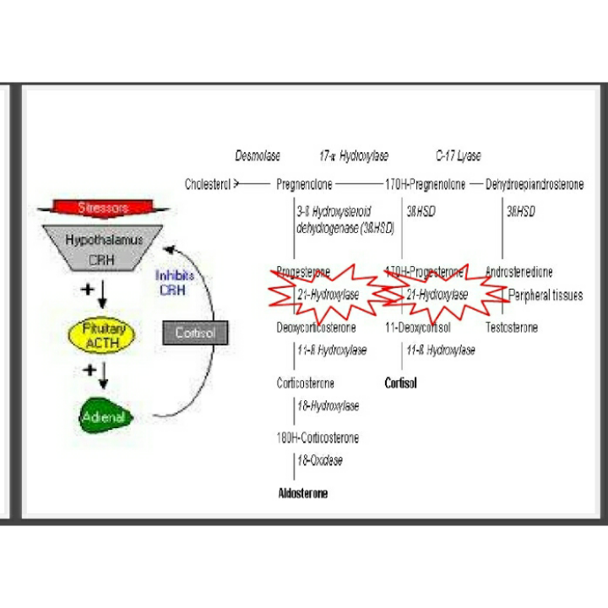

Slide 5
Types of CAH
21 hydroxylase deficiency (90 per cent) : it can either be classical or non classical
others: 11 alpha dehydroxylase deficiency, 17 alpha hydroxylase deficiency and the 3 beta hydroxysteroid dehydrogenase deficiency

Slide 6
Clinical manifestations
Cortisol deficiency: hypoglycaemia ,inability to withstand stress, hyperpigmentation, apneic spells,muscle weakness and fatigue.
Aldosterone deficiency: hyponatremia, hyperkalemia, vomiting, urinary sodium wasting, salt cravings, failure to thrive, hypotension, dehydration,shock ,diarrhoea.
Androgen excess: ambiguous genitalia , hisurtism, early appearance of pubic hair ,penile enlargement, excessive height gain .

Slide 7
Diagnosis
First suspected in a newborn infant with ambigous genitalia.
Adominal ultrasound (to detect the presence of uterus, cervix and vagina).
Elevated blood levels of 17 hdroxyprogesterone level.
Karyotyping (to establish the chromosomal sex)

Slide 8
Management
Glucocorticoids (oral cortisone) and monitor serum concentration of adrenal precursors and linear gowth and skeletal age assessment. Also used in prenatal treatement to reduce virilizing effects
Mineralcorticoid therapy (fludrocortisone) while monitoring serum sodium, potassium and plasma renin activity levels.
Surgical correction of ambigous genitalia by 1-2 years

Slide 9
Complications
Females : suboptimal breast enlargement, late menarche, amenorrhe a,irregular menses, reduced insulin sensitivity.
Males oligospermia, testicular tumor

Slide 10
references
Nelson Essential of paediatrics, 5th ed ,2006, Elsevier Inc.
Illustrated Textbook of paediatrics ,3rd ed, Tom Lissauer , Graham Clayden, 2007,Elsevier Limited.
Pediatrics Endocrinology , Mechanisms, manifestations and management,Ora H. Pescovitz ,Erica A. Eugster, 2004 by Lippincott Williams and Wilkins.

